Slide 1

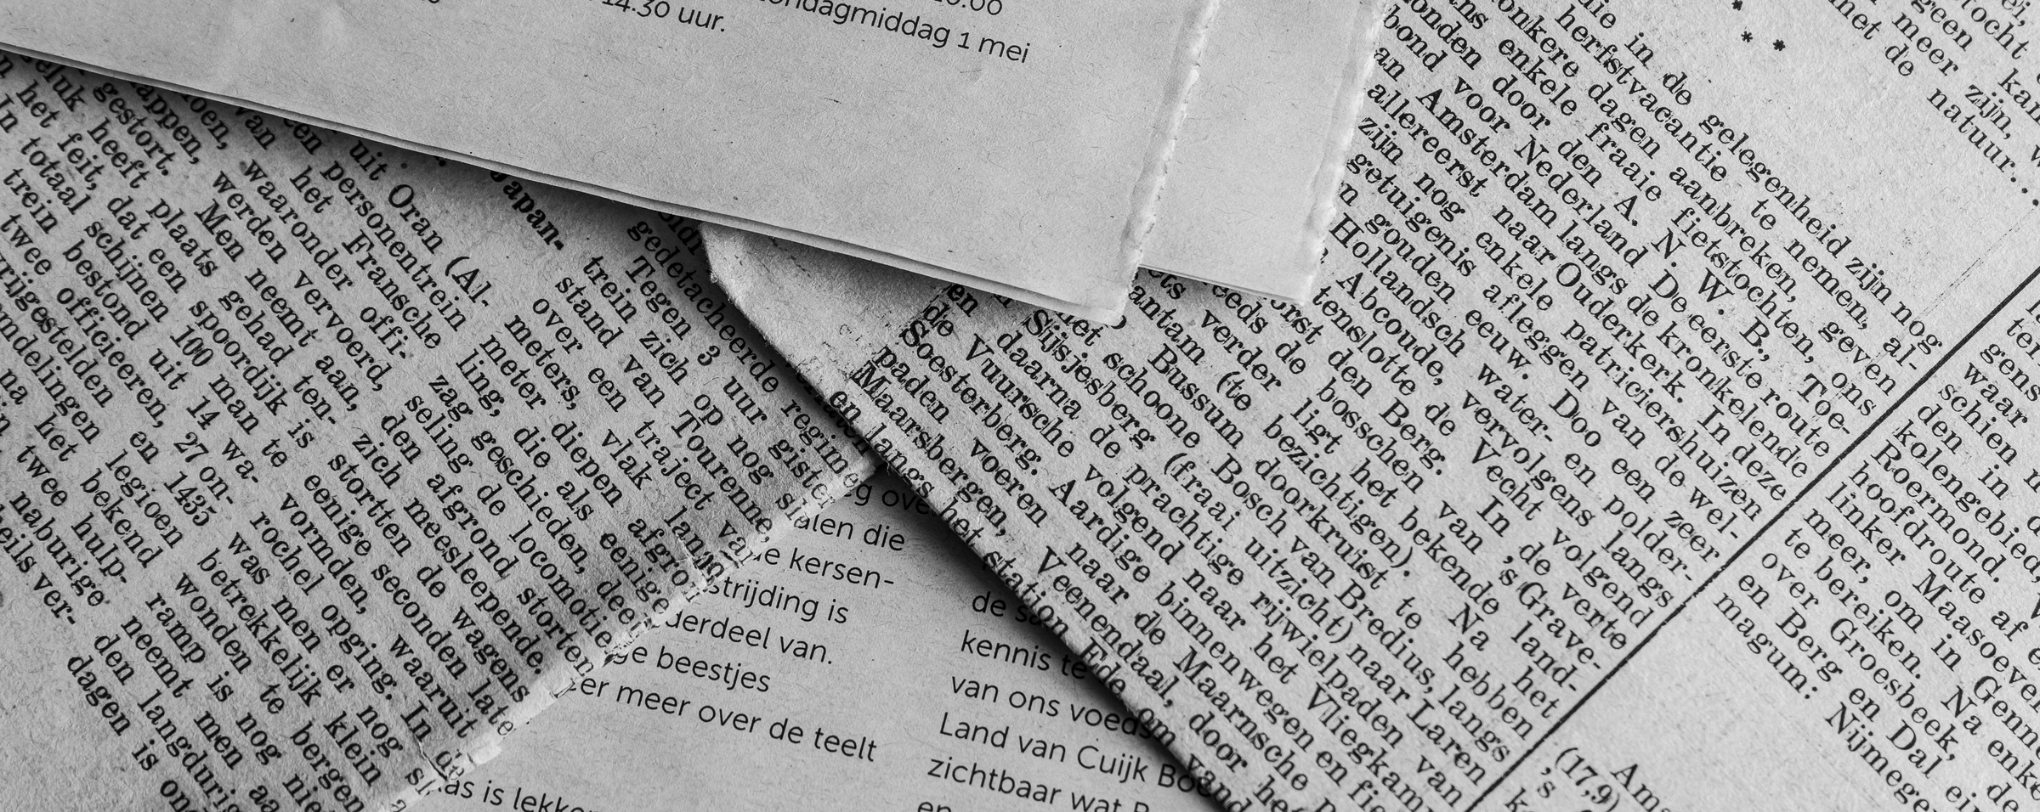
Unsupervised Machine Learning
Monday, March 4, 2024
NEWSPAPER ARTICLE TEXT ANALYSIS

Slide 2

Newspaper Article Text Analysis
Monday, March 4, 2024
Introduction
Source: Components.one
Dataset contains 2.7 million articles from and 27 American Publications.
10 features: date, year, month, day, author, title, article, URL, section, publication
Timeline: January 1, 2016 - April 2, 2020
Extracted data using BigQuery : Random Stratified Sampling (1%)
page 01

Slide 3
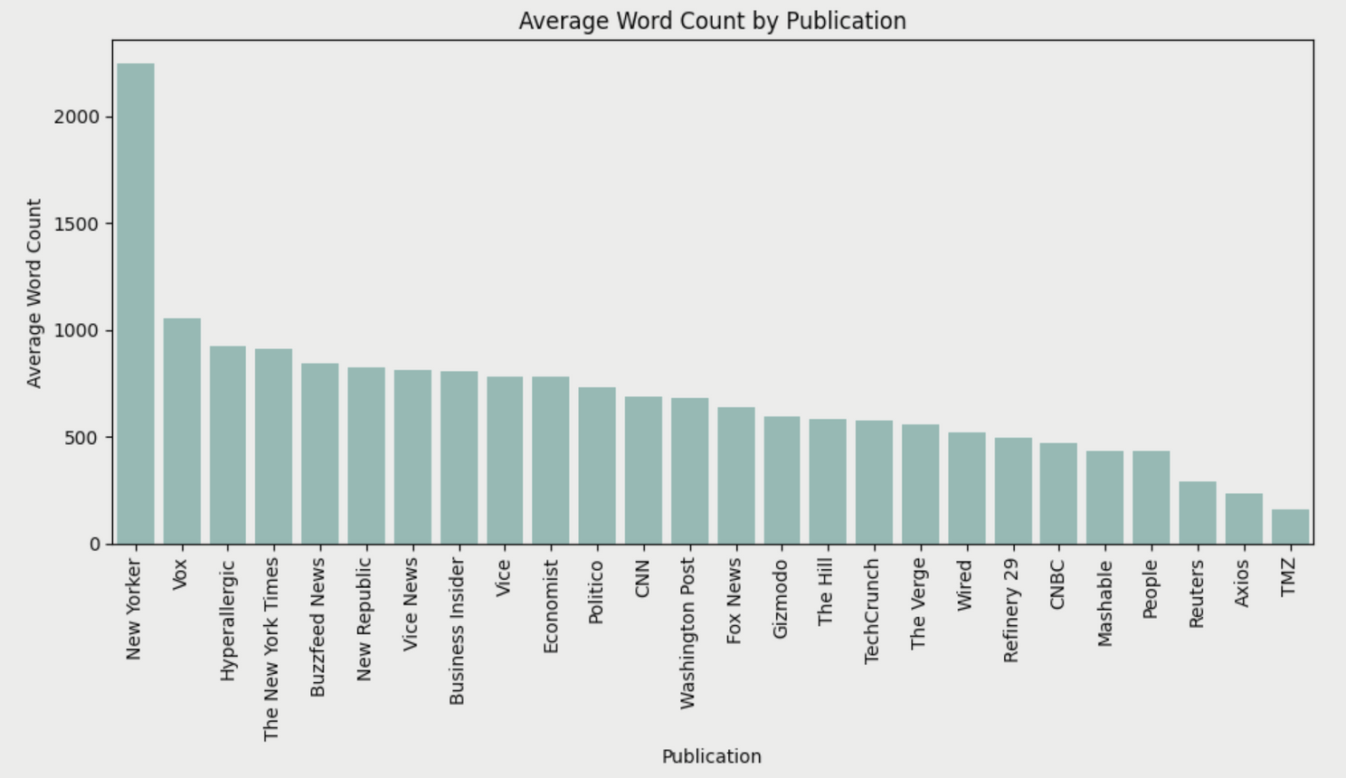
Newspaper Text Analysis
Monday, March 4, 2024
Exploratory Data Analysis
New Yorker : lengthiest articles followed by publications like Vox, Hyperallergic.
TMZ : shortest articles
Most of the publications’ articles range 0-1000 words on average except New Yorker.
page 02

Slide 4
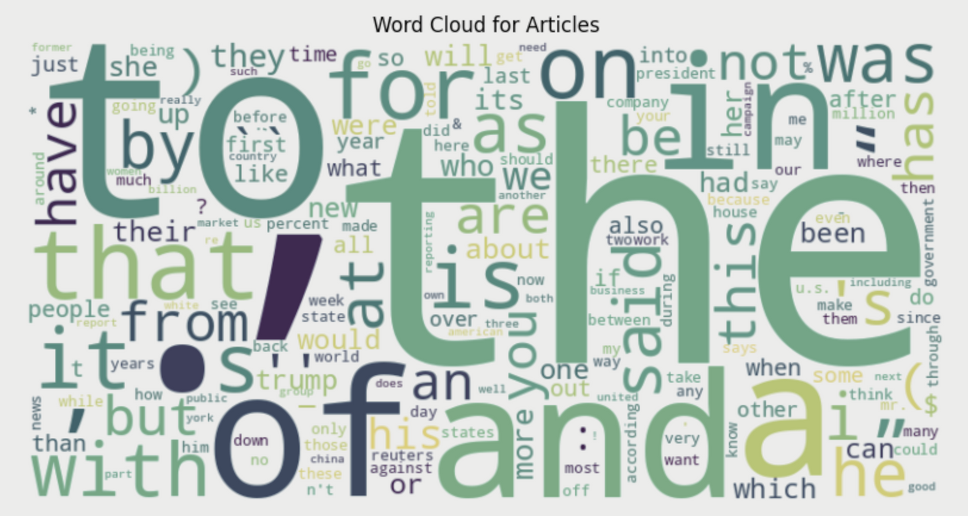
Newspaper Text Analysis
Monday, March 4, 2024
Exploratory Data Analysis
Subset: 9000 articles
Words like: “to”, “the”, “and”, “of” , “a”, “in”, etc.
Articles needs to be cleaned
page 03

Slide 5

Newspaper Text Analysis
Monday, March 4, 2024
Pre-processing
Text cleaning
Simplified words to their root
Tokenization and Vectorization
analyse the first 300 words result: 20,000 features
page 04

Slide 6
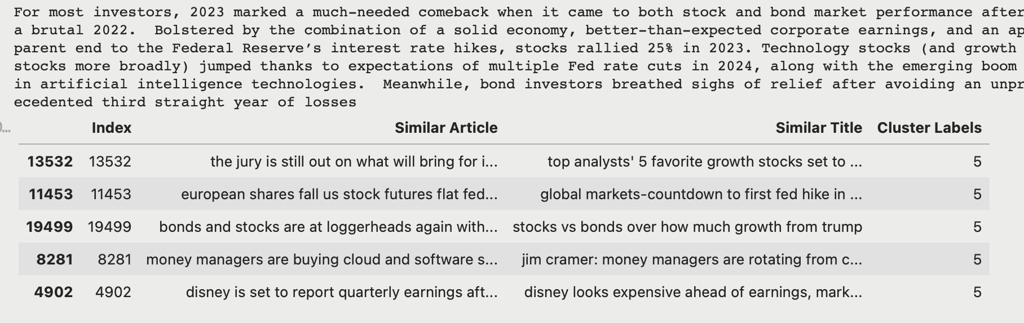
Newspaper Text Analysis
Monday, March 4, 2024
Recommendation system using co-sine similarity
page 05

Slide 7
Newspaper Text Analysis
Monday, March 4, 2024
Clustering with TF-IDF
Cluster | oil, crude, product, energi, us, gas, output, barrel, million, per
Cluster | game, season, score, win, first, team, two, second, play, three
Cluster | appl, cook, new, compani, watch, pro, tech, like, devic, market
Cluster | bank, central, rate, fed, interest, economi, percent, polici, inflat, monetari
page 06

Slide 8
Newspaper Text Analysis
Monday, March 4, 2024
Clustering with TF-IDF
Cluster | polic, peopl, shoot, man, offic, crime, suspect, accord, told, citi
Cluster | senat, democrat, hous, trump, republican, bill, vote, sander, presid, campaign
Cluster | trump, presid, hous, white, us, campaign, former, administr, report, elect
Cluster | like, one, new, time, get, peopl, work, go, show, first
page 07

Slide 9
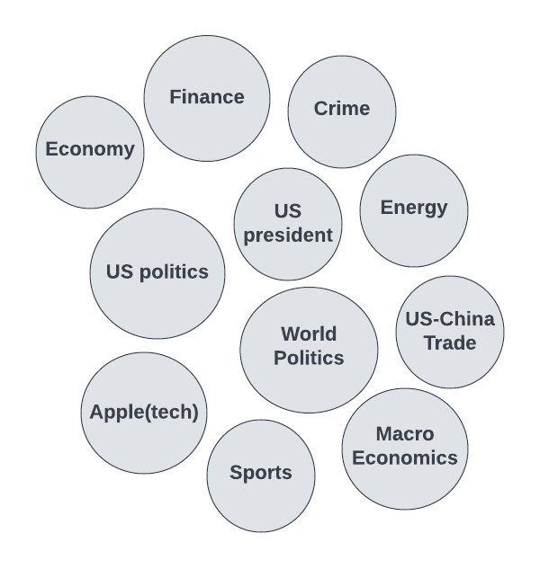
Newspaper Text Analysis
Monday, March 4, 2024
Clustering with TF-IDF
Cluster | percent, stock, index, growth, year, rose, quarter, market, us, fell
Cluster | million, versus, net, coverag, sourc, text, revenu, profit, compani, ago
Cluster | billion, million, compani, year, fund, market, percent, busi, invest, quarter
page 08

Slide 10
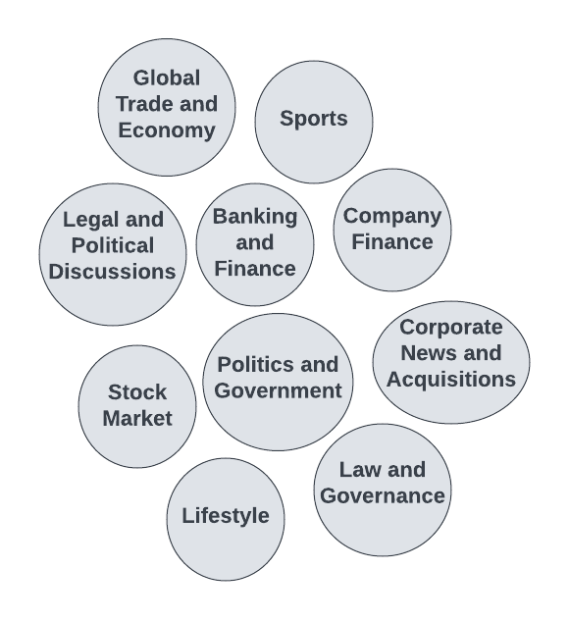
Newspaper Text Analysis
Monday, March 4, 2024
Non-negative Matrix Factorization
•Employed to classify news articles into different categories.
•Chose optimal number of topics through an iterative process.
•Obtained top 10 topics similar to the results from K-Means Clustering.
page 09

Slide 11
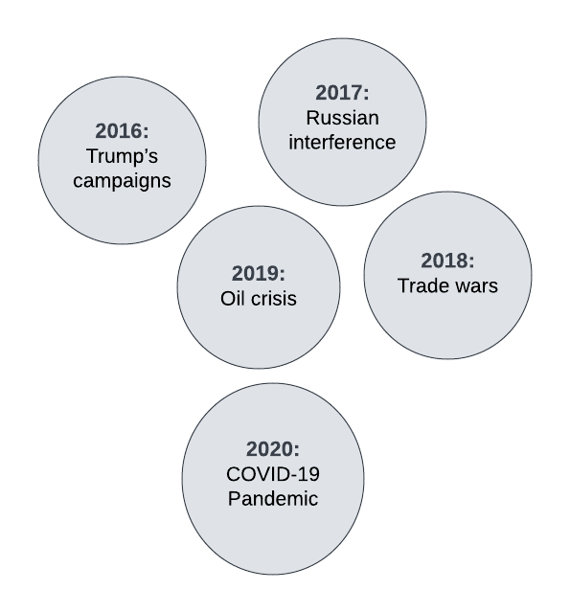
Newspaper Text Analysis
Monday, March 4, 2024
Non-negative Matrix Factorization (year-wise)
•Year-wise articles were used to classify news articles into different categories.
•Capture the current trends and classify them.
•The model captured one new topic every year.
•Suitable for real-world application as it utilizes less time for processing.
page 10

Slide 12

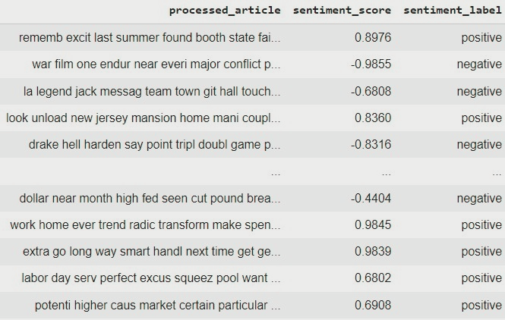
Newspaper Text Analysis
Monday, March 4, 2024
Sentiment Analysis
Chose optimal category and number of clusters
Computed sentiment score for each element of the 'processed_article' column
Standard sentiment labels are assigned to the rows based on the scores.
page 11

Slide 13
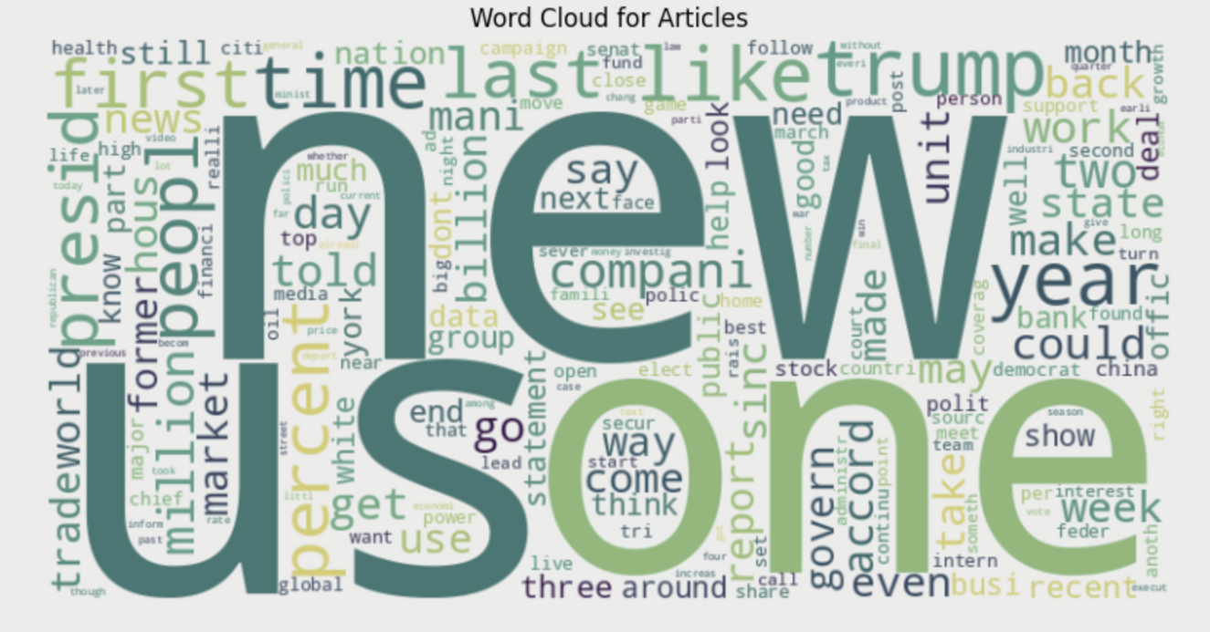
Newspaper Text Analysis
Monday, March 4, 2024
Conclusion and Next Steps
Business Benefits and Use cases for this model
Improvisations for individual cluster accuracy
Shortcomings of sentiment analysis for cluster based strings
page 12

Slide 14
Newspaper Text Analysis
Monday, March 2, 2024
THANK YOU FOR LISTENING!

